Slide 1


Slide 2

.
If S. P. > C.P., then
Profit = S. P. – C. P.
⇒ S. P. = C. P. + Profit
⇒ C. P. = S. P. – Profit.
if S.P. < C.P., then
Loss – C.P. – S.P.
⇒ C. P. = S. P. + Loss
S. P. = C. P. – Loss

Slide 3

Profit and loss percentage

Slide 4

Ram buys a book for Rs.100 and sells it for Rs.150. Find his gain or loss percentage.
CP =Rs.100
SP = Rs.150
Profit = SP – CP = 150 – 100 = Rs. 50
​Profit Percentage = (Profit / CP) x 100%
Profit Percentage = (50 / 100) x 100%
= (1/2)x100 %
= 50%

Slide 5
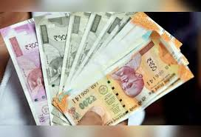
Sale price :
If there is a profit of P %, Cost Price = C SP = {(100+P)/100}xC
If there is a loss of L %, Cost Price = C SP = {(100-L)/100}xC

Slide 6
Cost price
If there is a profit of P %, Cost Price = C Sale price= SP Then C = {100/(100+p)} x SP
If there is a loss of L %, Then C = {100/(100-L)}xSP

Slide 7


When Seller Is Not Honest?

Slide 8

A seller uses a weighing stone of 900gms instead of 1 Kg. Find his real profit percent.
seller uses 900g weight instead of 1000g
Error = 1000 – 900 = 100
True value = 1000
Real Profit % = 100 / (1000 – 100) x 100 = 100/900 x 100 = 11.11%

Slide 9

Price CONSUMPTION

Slide 10

PRICE CONSUMPTION

Slide 11
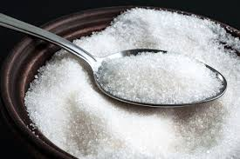
If price of sugar increases by 20% ,then the percentage reduction in consumption so that expenditure remains the same will be ?
=(20/(100+20))x100
= (20/120) x100
= 50/3%

Slide 12
Successive profits
If x% & y% PROFIT
net percentage profit =[x+y+xy/100]
If x% is profit&loss y%
net percentage profit or loss = [x – y – xy/100]

Slide 13
A sells an item at a profit of 20% to B and B sells it to C at a profit of 10%. Find the resultant profit percent .
net profit %= {x+y+(xy/100)}
= 20+ 10 + {(20 x 10)/100}
= 32%

Slide 14
PROFIT % LOSS %
%Loss= p² /100
Two items are sold for Rs 200.The first one is sold at 20% profit and second one at 20% loss. What is the % loss or gain ?
=> %loss = (20)²/100 = 4%

Slide 15


Slide 16
Discount = Marked Price – Selling Price SP=MP – Amount of Discount M (1-D%) = Selling Price
Selling Price = Cost Price + Gain
M (1-D%) = C (1 + G%)

Slide 17
Natasha offers her customers a discount of 10% on her beauty products and she still makes a profit of 20%. What is the actual cost to her of that beauty product marked Rs. 400?
Marked price = Rs. 400 Discount = 10% Profit = 20% Selling Price = 90% of 400 then 400 x 90/100 = Rs. 360 Selling price = Rs. 360 Profit = 20% Cost price = 100/120 x 360 = Rs. 300

Slide 18

successive discounts:
Selling Price = (1-x%)(1-y%) x MP

Slide 19
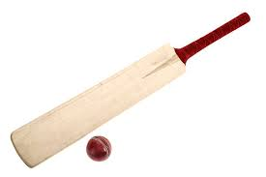
Pankaj offers a 10% discounts on his goods and he offers a further discount of 5% on the reduced price to those customers who pay cash. What does a customer have to pay in cash for a cricket bat of Rs. 200? : Price of the cricket bat = Rs. 200 After Discount of 10% =Rs. 180 After Discount of 5% = Rs.171

